Slide 1
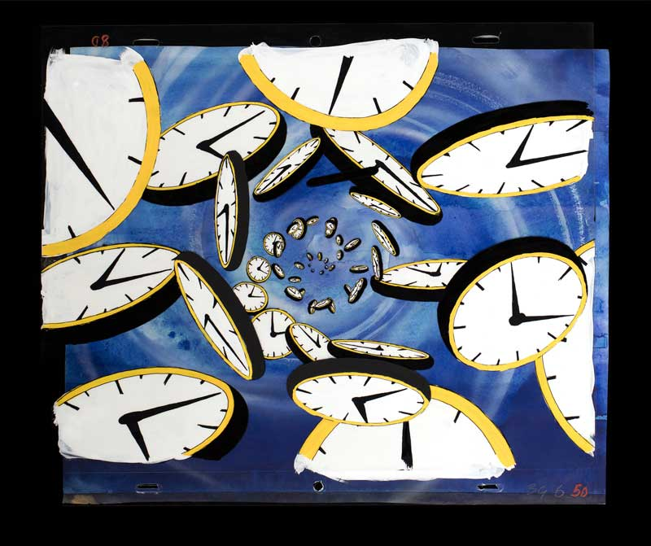

Procrastination
Procrastination
Common Causes and Fixes

Slide 2
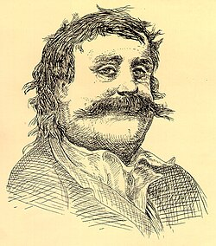
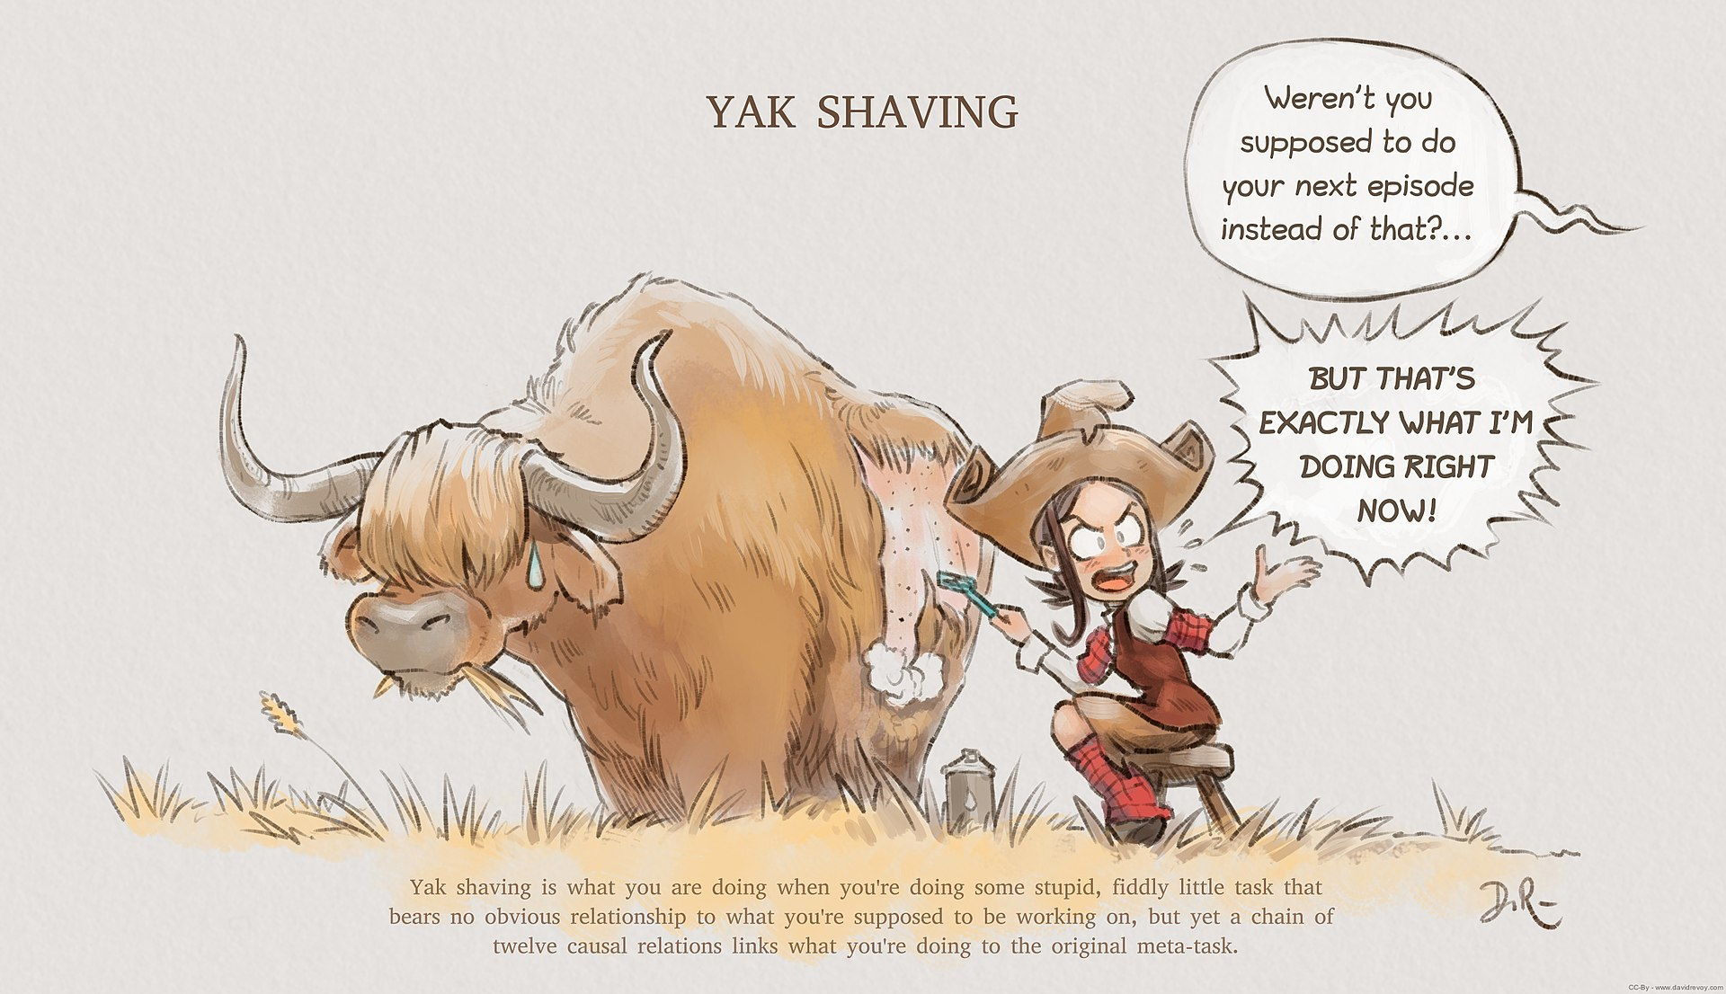




What is Procrastination?
From Wikipedia, the free encyclopedia
Procrastination is the act of unnecessarily delaying or postponing something despite knowing that there could be negative consequences for doing so. It is a common human experience involving delays in everyday chores or even putting off tasks such as attending an appointment, submitting a job report or academic assignment, or broaching a stressful issue with a partner. It is often perceived as a negative trait due to its hindering effect on one's productivity, associated with depression, low self-esteem, guilt, and feelings of inadequacy.^{[1]} However, it can also be considered a wise response to certain demands that could present risky or negative outcomes or require waiting for new information to arrive.^{[2]}
From a cultural and social perspective, students from both Western and Non-Western cultures are found to exhibit academic procrastination, but for different reasons. Students from Western cultures tend to procrastinate in order to avoid doing worse than they have done before or failing to learn as much as they should have, whereas students from Non-Western cultures tend to procrastinate in order to avoid looking incompetent or demonstrating a lack of ability in front of their peers.^{[3]} Different cultural perspectives of time management can impact procrastination. For example, in cultures that have a multi-active view of time, people tend to place a higher value on making sure a job is done accurately before finishing. In cultures with a linear view of time, people tend to designate a certain amount of time on a task and stop once the allotted time has expired.^{[4]}
A study of the behavioral patterns of pigeons through delayed gratification suggests that procrastination is not unique to humans but can also be observed in some other animals.^{[5]} There are experiments finding clear evidence for "procrastination" among pigeons, which show that pigeons tend to choose a complex but delayed task rather than an easy but hurry-up one.^{[6]}
Procrastination has been studied by philosophers, psychologists and, more recently, behavioral economists.^{[7]}

Slide 3


Introduction
Procrastination is a serious problem, especially among the young, unexperienced people. They tend to put things away for later, only for them to realize that the deadline is looming and they are completely unprepared.
Thypical example of Procrastination:
Cyberbullying
random people
Studying

Slide 4
Reasons for procrastination

Slide 5

Fear of failure, low motivation, and perfectionism often make it harder to start working on something.

Slide 6
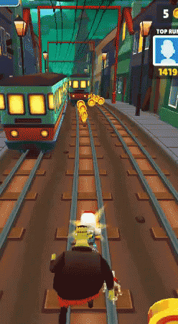
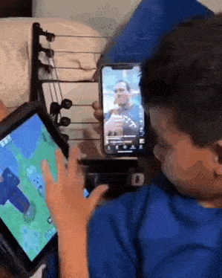

Environmental Influences
Distractions surrounding you often cause procrastination.

Slide 7

Unclear goals, overwhelming workload, and lack of interest in tasks often lead to procrastination.

Slide 8

Solutions to Procrastination

Slide 9


Time Management Techniques
Using tools like the Pomodoro Technique and prioritizing tasks helps increase focus and reduce delays. It’s also good to isolate yourself from every form of distractions.

Slide 10
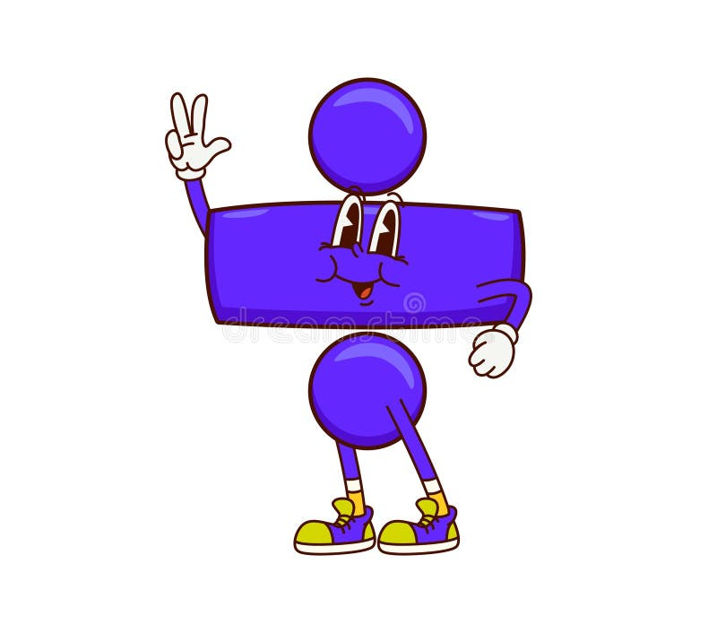

Behavioral Strategies
Dividing your goals into smaller parts and setting a reward system can boost your confidence and effectiveness significantly.

Slide 11

Environmental Adjustments
Creating a distraction-free workspace and setting clear deadlines improve productivity and task completion.

Slide 12
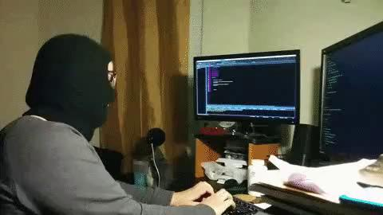

Lifestyle

Slide 13


Conclusions
Procrastination is hard to control, but with nothing but a little of dedication, you shall overcome it.
Everything is in your hands.

Slide 14





Questions
What is the main factor contributing to your procrastination? How do you deal with it?
Which solution to procrastination is most appealing to you and why?

